Slide 1
Learning and Performance Support Systems
Stephen Downes
27 Feb, 2014

Slide 2
World-Renowned Competencies
Advanced Analytics & Machine Reasoning
Individualized Learning Technologies
GaN Technologies & Devices
Advanced Photonic Communications Technologies
Printable Electronics
Analytical Techniques and Materials Characterization
Advanced Photonic Components
Optical Testing
Semiconductor Foundry Services
Gallium Nitride Electronics
NRC ICT
Portfolio
Functional Materials
Learning and Collaborative Technologies
Functional Devices
Cognitive Modelling
Functional Imprinting
Machine-Based
Learning/Reasoning
Data and Text Mining
Statistical-Based Machine Translation
Decision Support Systems
Human-Computer Interface Usability
Natural Language Processing
3D Interactive Visualization
Notes:
Our clients and partners tap into our extensive pool of highly sought-after technical experts, researchers, business specialists, software designers, programmers, and engineers in the fields of novel electronic and photonic devices, prototype development, advanced analytics and machine reasoning, and individualized learning technologies.
We are a multidisciplinary organization that can link ICT activities to other key sectors including aerospace, construction, surface transportation, energy, agriculture, and security and disruptive technologies, as you need. The broad spectrum of disciplines across NRC can help move technologies forward, and the exchange of ideas among areas of research within the same organization allows for rapid technological advancements in new and exciting sectors.
We are here to provide you with technology solutions for the following market segments:
Advance photonic communication technologies to support the exponentially growing global demand for telecommunication services.
GaN technologies and devices for the next generation of RF power transistor technology that offers higher power, higher efficiency and wider bandwidth than today’s solutions.
Printable Electronics solutions enable lower-cost digital manufacturing of ubiquitous electronic devices, transforming industries and creating new markets.
Advanced analytics and machine reasoning for long-term cost-effective solution in the area of data analytics.
Individualized learning technologies for reduced-cost training, knowledge and learning management.

Slide 3






The Skills Shortage in Canada
The Canadian Oil and Gas (O&G) sector alone loses an estimated $4 billion per year due to skills shortages.
25 job groups show signs of skills shortages. 21% of employment in Canada, these groups have an unemployment rate of less than 1%,
Training current and prospective employees is time-consuming and expensive.
August 26, 2013
Notes:
We already said that Skills shortages are costly to the economy
And, Formal modes of education and training can’t keep pace with the changing environment: what we learn is not valuable as long
There are several means, training is one of them.
Shrinking half-life of knowledge (basically, what we learn is not valuable as long)
Formal modes of education and training have not adapted
Plus, traditional platforms focus on the organizations using them.
And they are based on the one size fits all mentality (just like traditional education)
They are shifting their view, mostly because of their markets becoming saturated, but they still have unresolved issues.
There are other ways of addressing the problem
Like bringing skilled people in from other provinces, other countries
We don’t believe this is a long term solution
But, one of the ways is to provide the means to more efficiently ‘skill’ people.
Through adapting to the user, not forcing the user to adapt to a ‘course’ or ‘program’ or whatever. Yes, initial education and skilling is important. But lifelong learning needs better tools.

Slide 4


Why NRC?
NRC is a globally recognized leader in emerging learning technologies
  Not core competencies for target clients
  LPSS benefits from NRC’s research in other fields
NRC is deeply connected to the e-learning industry
  University researchers not driven to spend the time with industry
  NRC by contrast has collaboration and commercialization experience
  Neutral broker reduces risk to technology development partners
Notes:
NRC owns existing component technologies that de-risk solution development and reduce time to market: TRL range from 3 to 9.
These are not technologies owned or likely to be developed by either O&G or learning technology industries
Expertise. NRC is a globally recognized leader in emerging learning technologies with a proven track record of forecasting where technology will be years in advance of the field.
Because we aren’t in the business of selling oil, software or content, we can provide a crucial horizontal link between the enterprises that do.
NRC has successfully developed, transferred and licensed learning technologies to solution providers.

Slide 5

LPSS program
Personal Learning and Performance Support
Single point of access to all skills development and training needs
Individual learning path
Context-aware support
Searchable and verifiable
Tailored to industry needs
Always available

Slide 6
LPSS Program Overview
LPSS is a $19 million program over 5 years, average 30 FTEs per year
Based on hosted services used to develop and monetize core technologies, which are then transferred to commercial receptors
Will work with Canadian learning technology providers and target verticals to address critical skills shortages in that industry
Revenues during program execution, with potential for ongoing licensing revenues

Slide 7
Learning and Performance Support System:
Core Technology Development Projects
Learning services network and marketplace
Automated skills development and recognition
Lifetime management of learning and training records and credentials
Personal learning assistant to view, update and access training
Resource Network
Learning Assistant
Automate Skills Dev.
Personal Learning Records
Learning as a cloud service and deep integration with external systems
Notes:
the solution would consist of the main components as shown on the slide
Learning as a Cloud Service - will create a distributed learning layer, which is mechanism for working with data no matter where it is stored, through desktop, mobile and other devices.
Resource Repository Network – will create a resource graph from multiple sources and multiple formats including live and dynamic data such as oilfield data, refinery instrumentation, or Oil and Gas market information.
Personal Learning Record - this project will define how we represent, capture, and leverage user activity, including ratings, test results, performance measures, and the like, in a distributed learning and work environment.
Automated Competence Development And Recognition – whereas existing recommender systems depend on manually defined metrics, this system will detect new and emerging competences and automatically assess employee performance.
Personal Learning Assistant – this project will develop an integrated learning appliance, a mechanism for looking up or finding references or resources inside other programs or environments.

Slide 8
The Program Business Model
Two-phase business model, based first on the development of hosted services, and second on the transfer of technology and client base to strategic partners.
1
Capacity development through hosted projects
Monetization through through development agreements and fee-for-service
2
Transfer of program assets to the commercial sector
Consolidation of revenue and exit.

Slide 9
What is LPSS?
WAVE
Workflow Analysis, Visualization and Enhancement
MOOC-REL
Massive Open Online Course Ressources Éducatives Libres
MINT
Multimodal INteractive Trainer
RRN
PCL
PLR
ACDR
PLA
WORLD
DATA
EXTERNAL
DATA Services
EXTERNAL
APPS
COMMON PLATFORM
Services, Communications, Management
MATS
Program
Technologies
NRC Programs
Government
Departments
It’s a network of personal learning environments…
… connected to a large array of learning services

Slide 10
Core Projects, Implementation Projects

Slide 11
Why Is This Difficult?
It’s not one big thing…
… but a set of many small things
Tasks that are simple in an enterprise system…
  Like data storage
  Like content distribution
  Like authentication
  Like analytics
… become that much more difficult

Slide 12
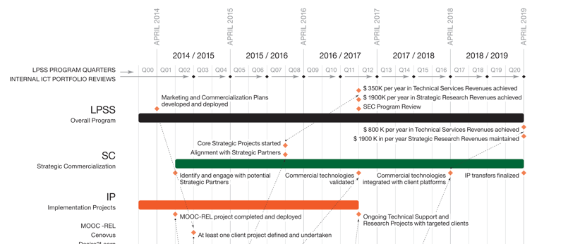
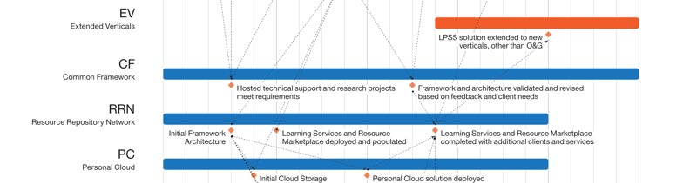
What is the LPSS Program?

Slide 13
Highlights
Value Proposition:
Problem: skills shortage in Canadian professions and industry
Solution: personal skills development infrastructure
Market Pull:
Ongoing negotiations with Ed Tech and Insuctry Clients
Projects with universities, government departments, international bodies
Program Design Based on Engagement:
Product and service development with end-user clients
Transfer and commercialization to Ed Tech partners

Slide 14
Contacts
Stephen Downes
Stephen.Downes@nrc-cnrc.gc.ca
Rodrigue.Savoie
Rodrigue.Savoie@nrc-cnrc.gc.ca
http://nrc-cnrc.gc.ca/eng/solutions/collaborative/lpss.html
http://nrc-cnrc.gc.ca/fra/solutions/collaborative/saar.html

